Slide 1

Refactoring & Extending MILP-Based Buffer Placement
Yuan Qin
10.06.2025
Supervisor: L. Josipovic, J. Xu

Slide 2
Refactoring & Extending MILP-Based Buffer Placement
What is a Buffer?
A hardware module that accommodates tokens (valid data flowing through the circuit) and
breaks timing paths.
What is the Buffer Placement MILP?
An optimization algorithm formulated as Mixed-Integer Linear Programs, used to
determine buffer locations and types in the dataflow circuit.
What is the Buffer Placement Pass?
Maps the MILP solution to synthesizable buffer hardware.
Why refactor & extend?
To support new algorithms and new buffer types.
Notes:
Add a new slide, pr with introduction, as a catalogue.
Say what buffers do and how milp place buffers

Slide 3
Work Overview
1. Buffer Placement Pass Redesign
Add ‘buffer type’ attribute (PR #317).
Add new buffer type HDL modules (PR #407)
2. MILP Extension
Modularize MILP constraints (PR #392).
Add new constraints, objective (PR #414) and a new algorithm (PR #472).
3. Issues in the Current Dynamatic Buffering
Internal Buffers in Merge-like Components (Issue #342, PR #356)
Latency Imbalance on the Load-Store Queue (Issue #388, PR #356)
Memory Controller’s Load Bottleneck (Issue #401)
Ambiguity in the Timing Attribute (PR #317, PR #429)
FPL22’s Model Requires Correct Throughput Constraints (PR #427)
Buffering Group’s Limitations (PR #393)
Simplifying MILP using Precomputed Throughput (Issue #456)
Notes:
Here’s a quick overview of what this work includes — I’ll mainly talk through the core points .

Slide 4
Buffer Placement
MILP Result
BufferOp
HDL Module
Optimization variables
Not directly mappable to RTL
Contains:
Opaque/Transparent
Slot number
Synthesizable buffer
Four distinct modules
How to determine which module to instantiate:
 | Opaque | Transparent
Slot number = 1 | OEHB | TEHB
Slot number > 1 | OFIFO | TFIFO
Let’s elaborate on these modules a bit…
Notes:
On a channel
Change a half of the slide in the next;
Transparency slot; two cannot describe three;

Slide 5
Buffer Placement
A buffer is not monolithic, but is comprised of multiple slots.
Buffers differ because their slots can vary.
Unit
Buffer
Unit
Notes:
On a channel
Change a half of the slide in the next;
Transparency slot; two cannot describe three;

Slide 6
Buffer Placement
A buffer is not monolithic, but is comprised of multiple slots.
Buffers differ because their slots can vary.
Each of the four buffer modules in Dynamatic can be broken down into combinations of the following three slot types.
From the timing perspective:
From the throughput perspective:
Signal Types:
Data (D), Valid (V), Ready (R)
A buffer contains either a token or a bubble.
Sometimes a token/bubble cannot pass through
the buffer within one cycle.
D
V
R
T
Notes:
Change a half of the slide in the next;
Transparency slot; two cannot describe three;

Slide 7
Buffer Placement
D
V
R
T
 | Opaque | Transparent
Slot number = 1 | OEHB | TEHB
Slot number > 1 | OFIFO | TFIFO
Opaque
Transparent
D
V
R
D
V
R
OEHB:
TEHB:
D
V
R
D
V
R
OFIFO:
TFIFO:
Slot number
Slot number
Notes:
HDL modules show their real characteristics

Slide 8
Buffer Placement
D
V
R
T
Opaque
Transparent
D
V
R
D
V
R
OEHB:
TEHB:
D
V
R
D
V
R
OFIFO:
TFIFO:
A problem comes: Now we want these buffers.
D
V
R
D
V
R
D
V
R
The current buffer placement pass is not general enough to express them.
Notes:
HDL modules show their real characteristics

Slide 9
Buffer Placement
D
V
R
T
A problem comes: Now we want these buffers.
D
V
R
D
V
R
D
V
R
The current buffer placement pass is not general enough to express them.
Solution:
Remove Opaque/Transparent.
Encode ‘Buffer type’ in BufferOp instead, which directly points to a HDL module.
Concatenate multiple BufferOps on a channel.
Notes:
Each of them assigned a slot number, and a channel can have all the types concatenated
Separable; Unseparable but parameter to control slot number

Slide 10
Buffer Placement
D
V
R
D
V
R
T
A problem comes: Now we want these buffers.
D
V
R
D
V
R
The current buffer placement pass is not general enough to express them.
Solution:
Remove Opaque/Transparent.
Encode ‘Buffer type’ in BufferOp instead, which directly points to a HDL module.
Concatenate multiple BufferOps on a channel.
Notes:
Each of them assigned a slot number, and a channel can have all the types concatenated
Separable; Unseparable but parameter to control slot number

Slide 11
Buffer Placement
D
V
R
D
V
R
T
MILP Result
BufferOp
HDL Module
Optimization variables
Not directly mappable to RTL
Contains:
Opaque/Transparent
Slot number
Synthesizable buffer
Four distinct modules
Solution:
Remove Opaque/Transparent.
Encode ‘Buffer type’ in BufferOp instead, which directly points to a HDL module.
Concatenate multiple BufferOps on a channel.
Notes:
Each of them assigned a slot number, and a channel can have all the types concatenated
Separable; Unseparable but parameter to control slot number

Slide 12
Buffer Placement
D
V
R
D
V
R
T
MILP Result
BufferOp
HDL Module
Optimization variables
Not directly mappable to RTL
Contains:
Buffer type
Slot number
Synthesizable buffer
Four distinct modules
Solution:
Remove Opaque/Transparent.
Encode ‘Buffer type’ in BufferOp instead, which directly points to a HDL module.
Concatenate multiple BufferOps on a channel.
Example:
BufferOp: {Buffer type: OEHB, Slot number: 1}
If we want an OEHB.

Slide 13
Buffer Placement
D
V
R
D
V
R
T
Solution:
Remove Opaque/Transparent.
Encode ‘Buffer type’ in BufferOp instead,
which directly points to a HDL module.
3. Concatenate multiple BufferOps on a channel.
Existing modules for reference:
D
V
R
OEHB:
Example:
D
V
R
TEHB:
BufferOp: {Buffer type: OEHB, Slot number: 1}
D
V
R
D
V
R
TFIFO:
Slot number

Slide 14
Buffer Placement
D
V
R
D
V
R
T
Solution:
Remove Opaque/Transparent.
Encode ‘Buffer type’ in BufferOp instead,
which directly points to a HDL module.
3. Concatenate multiple BufferOps on a channel.
Existing modules for reference:
D
V
R
OEHB:
Example:
D
V
R
TEHB:
BufferOp: {Buffer type: OEHB, Slot number: 2}
D
V
R
D
V
R
TFIFO:
For the one-slot module, we chain multiple modules.
Slot number

Slide 15
Buffer Placement
D
V
R
D
V
R
T
Solution:
Remove Opaque/Transparent.
Encode ‘Buffer type’ in BufferOp instead,
which directly points to a HDL module.
3. Concatenate multiple BufferOps on a channel.
Existing modules for reference:
D
V
R
OEHB:
Example:
D
V
R
TEHB:
BufferOp: {Buffer type: TFIFO, Slot number: 2}
D
V
R
D
V
R
TFIFO:
For the multiple-slot module, we directly use slot number.
Slot number

Slide 16
Buffer Placement
D
V
R
D
V
R
T
Solution:
Remove Opaque/Transparent.
Encode ‘Buffer type’ in BufferOp instead,
which directly points to a HDL module.
3. Concatenate multiple BufferOps on a channel.
Existing modules for reference:
D
V
R
OEHB:
Example:
D
V
R
TEHB:
BufferOp: {Buffer type: OEHB, Slot number: 2}
BufferOp: {Buffer type: TFIFO, Slot number: 2}
D
V
R
D
V
R
TFIFO:
Slot number

Slide 17
Buffer Placement
D
V
R
D
V
R
T
Solution:
Remove Opaque/Transparent.
Encode ‘Buffer type’ in BufferOp instead,
which directly points to a HDL module.
3. Concatenate multiple BufferOps on a channel.
Existing modules for reference:
D
V
R
OEHB:
Example:
D
V
R
TEHB:
BufferOp: {Buffer type: OEHB, Slot number: 2}
BufferOp: {Buffer type: TFIFO, Slot number: 2}
BufferOp: {Buffer type: TEHB, Slot number: 1}
D
V
R
TFIFO:
D
V
R
Slot number

Slide 18
Buffer Placement
D
V
R
T
BufferOp
BufferOp
MILP Result
BufferOp
BufferOp
BufferOp
BufferOp
BufferOp
HDL module
Optimization variables
Not directly mappable to RTL
Contains:
Buffer type
Slot number
Synthesizable buffer
Four distinct modules
Solution:
Remove Opaque/Transparent.
Encode ‘Buffer type’ in BufferOp instead, which directly points to a HDL module.
Concatenate multiple BufferOps on a channel.
Example:
BufferOp: {Buffer type: OEHB, Slot number: 2}
D
V
R
BufferOp: {Buffer type: TFIFO, Slot number: 2}
BufferOp: {Buffer type: TEHB, Slot number: 1}

Slide 19
Buffer Placement
D
V
R
T
BufferOp
BufferOp
MILP Result
BufferOp
BufferOp
BufferOp
BufferOp
BufferOp
HDL module
Optimization variables
Not directly mappable to RTL
Contains:
Buffer type
Slot number
Synthesizable buffer
Four distinct modules
Other Advantages:

Slide 20
Buffer Placement
D
V
R
T
BufferOp
BufferOp
MILP Result
BufferOp
BufferOp
BufferOp
BufferOp
BufferOp
HDL module
Optimization variables
Not directly mappable to RTL
Contains:
Buffer type
Slot number
Synthesizable buffer
Four distinct modules
Other Advantages:
Simplify the logic in the RTL backend.
Previously: A combination of attributes to select.
Now: Direct mapping.
 | Opaque | Transparent
Slot number = 1 | OEHB | TEHB
Slot number > 1 | OFIFO | TFIFO
Buffer type | HDL module
… | …
… | …

Slide 21
Buffer Placement
D
V
R
T
MILP Result
BufferOp
HDL Module
Optimization variables
Not directly mappable to RTL
Contains:
Opaque/Transparent
Slot number
New descriptive attributes…
Synthesizable buffer
Four distinct modules
Other Advantages:
Simplify the logic in the RTL backend.
Scalable for new buffer types.
 | Opaque | Transparent
Slot number = 1 | OEHB | TEHB
Slot number > 1 | OFIFO | TFIFO
Previously:
How to differentiate them? Add new attributes?
Update BufferOp; affects all buffer types.
HDL translation becomes even more complicated
(combinations of more attributes).
D
V
R

Slide 22
Buffer Placement
New buffer types
New HDL modules
BufferOp
HDL module
BufferOp
HDL module
BufferOp
BufferOp
MILP Result
BufferOp
BufferOp
BufferOp
BufferOp
BufferOp
HDL module
Optimization variables
Not directly mappable to RTL
Contains:
Buffer type
Slot number
Synthesizable buffer
Six distinct modules
Other Advantages:
Simplify the logic in the RTL backend.
Scalable for new buffer types.
Now: We only add new buffer types without changing the previous implementation.

Slide 23
MILP Framework
Base class defines functions
Derived classes (algorithms) call functions
Timing Constraints
Algorithms
Throughput Constraints
Objective
Notes:
Say if a new algorithm is added, then how to do it , add and change what;
Goal: if I want to add a new algorithm , how;

Slide 24
MILP Framework
Base class defines functions
Derived classes (algorithms) call functions
Timing Constraints
Algorithms
Throughput Constraints
New Algorithm
Cost-Aware Buffers
New Throughput Constraints
Objective
New Objective
Notes:
Say if a new algorithm is added, then how to do it , add and change what;
Goal: if I want to add a new algorithm , how;

Slide 25
MILP Extension
D
V
R
T
New throughput constraints: Model the general buffer configurations.
Example: A 5-slot buffer breaking DVR.
D
V
R
Modeled in the previous
throughput constraints.
1. Use OFIFO
(previously supported)
D
V
R
2. Chain the OEHBs
(previously not supported)
Modeled in a new set of throughput constraints, which is stricter compared to OFIFO.
D
V
R
3. Use the new buffer
(previously not supported)

Slide 26
MILP Extension
D
V
R
T
New objective: model area cost for each buffer type.
Higher area → higher penalty, favoring low-area-cost buffers.
D
V
R
1. Use OFIFO
(previously supported)
High area cost
D
V
R
2. Chain the OEHBs
(previously not supported)
Low area cost
D
V
R
3. Use the new buffer
(previously not supported)
Lowest area cost

Slide 27
MILP Extension
D
V
R
T
Cost-Aware Buffers: Trade off constraint strictness and area cost. Prefer lower-area buffers when stricter constraints are met.
D
V
R
High area cost / Relaxed constraints
1. Use OFIFO
(previously supported)
D
V
R
Low area cost / Strict constraints
2. Chain the OEHBs
(previously not supported)
D
V
R
Lowest area cost / Most strict constraints
3. Use the new buffer
(previously not supported)

Slide 28
Existing Issues: Internal Buffers
Reason: To avoid token reordering.
Problems:
Token reordering does not always occur → Internal buffers may waste area
Characterization is complex → Must track which units break signal paths internally
Solution:
Remove internal buffers
Let MILP place buffers only when token reordering happens
Merge
Mux
TEHB
TEHB

Slide 29
Existing Issues: Latency Between Allocations and Load/Store Operations
Problem:
The MILP does not model LSQ behavior.
Necessary buffers are not placed.
This leads to throughput degradation.
Temporary workaround:
When a Load/Store unit is connected to the LSQ, the MILP places a buffer on its input channel.
Without buffer, II = 2
With buffer, II = 1
C1
C2
C3
C4
C1
C2
C3
C4
Iter 1
Alloc1
Iter 1
Alloc1
ST1
ST1
Iter 2
Alloc2
Iter 2
Alloc2
ST2
ST2
Iter 3
Alloc3
ST3

Slide 30
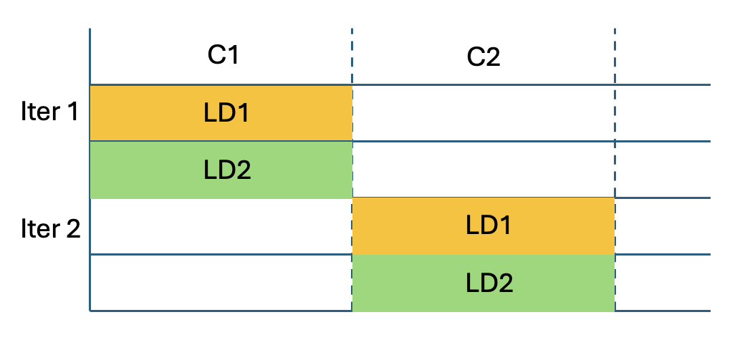
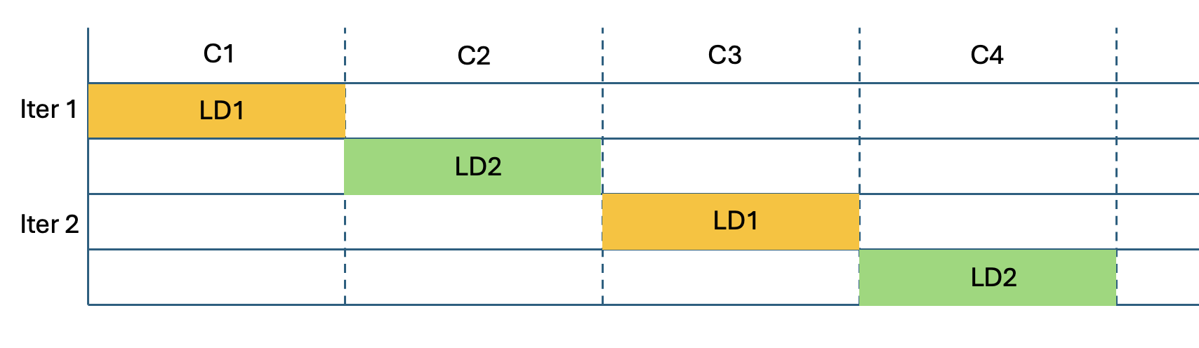
Existing Issues: Load Bottleneck on Memory Controller
Problem:
The MILP is unaware of port contention, which leads to inaccurate modeling.
Ideally, II = 1
With port contention, II = 2

Slide 31
Thank you!

Slide 32
Buffer Placement
D
V
R
T
Why we keep this buffer type?
FIFO_BREAK_DV: OFIFO without TEHB.
D
V
R
OFIFO is separable, but this is not separable.
Different in timing delay and area cost from
ONE_SLOT_BREAK_DV+FIFO_BREAK_NONE.
Future MILPs might exploit the difference.
Notes:
The other three are enough and clear.
Where it come from
It is similar to what
Why keep this

Slide 33
Existing Issues: Buffering Group’s Limitations
Before
After
Before
After
Supported
Not supported
Not supported

Slide 34
Existing Issues: Simplifying MILP using Precomputed Throughput
If the model does not consider buffer delay. The placement of buffers does not affect timing constraints.
Timing constraints decide the best throughput. Throughput constraints only affect the buffer placement, but not the best throughput.
The objective always requires the best throughput. Hence, the model must finally achieve this value.
After solving timing constraints only, we know the best throughput. Substituting the known value into the throughput constraints makes the model simpler.
This is because the throughput variable always exists in the throughput constraints. By constant substitution, quadratic terms become linear, and linear terms become constant.
Experiments show several hundred times speedup on a quadratic model.

Slide 35
Existing Issues: Ambiguity in the Timing Attribute
D
V
R
As a timing attribute, what does Opaque/Transparent mean throughout Dynamatic?
There’s never a consistent meaning.
In the RTL backend (HDL modules):
Opaque:
Transparent:
D
V
R
D
V
R
OEHB:
TEHB:
D
V
R
D
V
R
OFIFO:
TFIFO:
≥ 0
≥ 2
Notes:
Join the three together in a slide
Explain what is timing attribute
Many parts use timing to make decisions, we still need timing attribute, but not opaque and transparent. (We use opaque transparent to define timing)
Back to the question:

Slide 36
Existing Issues: Ambiguity in the Timing Attribute
D
V
R
As a timing attribute, what does Opaque/Transparent mean throughout Dynamatic?
There’s never a consistent meaning.
In the previous BufferOp’s timing attribute:
Opaque:
Break DV.
Transparent:
Break R.
D
V
R
D
V
R
≥ 0
≥ 0

Slide 37
Existing Issues: Ambiguity in the Timing Attribute
D
V
R
As a timing attribute, what does Opaque/Transparent mean throughout Dynamatic?
There’s never a consistent meaning.
In the MILP’s throughput model (proposed in FPGA 20):
Opaque:
Transparent:
D
V
R
D
V
R
≥ 0
≥ 1
Why are they so confusing?
They’re trying to represent four conditions using only two values.
Notes:
Back to how they are defined, the paper
If you don’t remember the previous conditions, this is right, because the fact of Dynamatic’s buffering is just a mess as you see.

Slide 38
Existing Issues: Ambiguity in the Timing Attribute
Solution:
Use four values to represent the timing attributes.
break_dv, break_r, break_dvr, break_none.
A BufferOp has: timing attribute, buffer type, slot number.
ONE_SLOT_BREAK_DV
break_dv
FIFO_BREAK_DV
break_dvr
ONE_SLOT_BREAK_DVR
SHIFT_REG_BREAK_DV
break_r
ONE_SLOT_BREAK_R
break_none
FIFO_BREAK_NONE
Notes:
Change to: previous code did what(timinginfo::oehb() if-condition), now do what

Slide 39
Existing Issues: Latency Between Allocation and Load/Store
T
T
T
II = 2
T
T
T
Cycle 1
Cycle 2
Notes:
Use schedule;need build model but there is no;delete current figures

Slide 40
Existing Issues: Latency Between Allocation and Load/Store
T
T
T
T
T
Buffer
Buffer
II = 1
T
T
T
T
Cycle 1
Cycle 2

Slide 41
Existing Issues: Latency Between Allocation and Load/Store
Currently, there’s no systematic way for the MILP to handle this issue.
A proposed model:
A FIFO with one latency.
MILP requires token occupancy equivalence
between Fork – Join paths.
Buffers on store paths will be placed by MILP
if necessary.
Limitation:
Not accounting for the relationship between
other paths.
Temporary workaround:
Enforce a buffer before ‘Store’ in this condition.
Notes:
The workaround improved many benchamrks whose actual throughput is not like the milp solution.

Slide 42
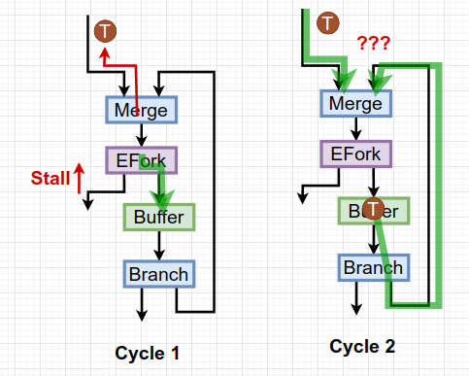
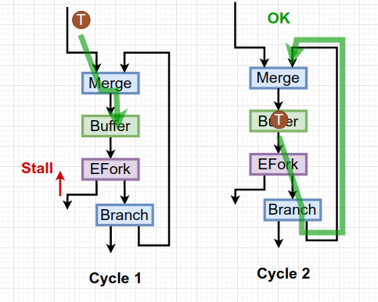
Token Reordering

Slide 43
Token Reordering
When we need an internal buffer on the output?
It is a Merge, not Mux.
There’s a fork downstream.
They are on the cycle.
There’s no buffer on the output channel
according to the MILP.

Slide 44
Existing Issues: FPL 22 Requires a Correct Throughput Model
FPGA 20 uses a variable R_{c} to indicate whether the buffer on a channel breaks signal paths.
In the timing constraints, if R_{c} is true, then:
Both DV and R signal paths are broken.
In the thoughput constraints, if R_{c} is true, then:
Token occupancy ≥ CFDFC’s throughput
Bubble occupancy ≥ CFDFC’s throughput
FPL 22’s timing model allows breaking DV and breaking R to be set independently.
In the timing constraints, R_{c} is split into break-DV and break-R:
If break-DV is true, then DV signal paths are broken.
If break-R is true, then R signal paths are broken.
Problem: FPL 22 has no throughput model considering break-DV and break-R separately.
Notes:
Cause incorrect modeling.
Implementation is wrong, only show the previous constraints (which is wrong, paper is right) and current constraints of throughput. No need to mention timing and paper.

Slide 45
Existing Issues: FPL 22 Requires a Correct Throughput Model
Solution:
Add the throughput constraints for FPL 22:
If break-DV is true, token occupancy ≥ CFDFC’s throughput
If break-R is true, bubble occupancy ≥ CFDFC’s throughput

